Slide 1

Homework
Open a new Excel sheet
Enter data in the cells, change font style, font size-14, text colour
Apply cell style and format data
Save your project as “Homework on cell formatting”.

Slide 2
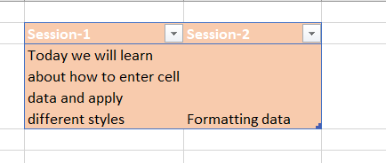
Homework Solution

Slide 3






Excel
Session - 3

Slide 4


Insert tab and Working with charts
Adding images,shapes,icons
Adding SmartArt
Chart Types
Picture Fill
Adjust Chart size

Slide 5
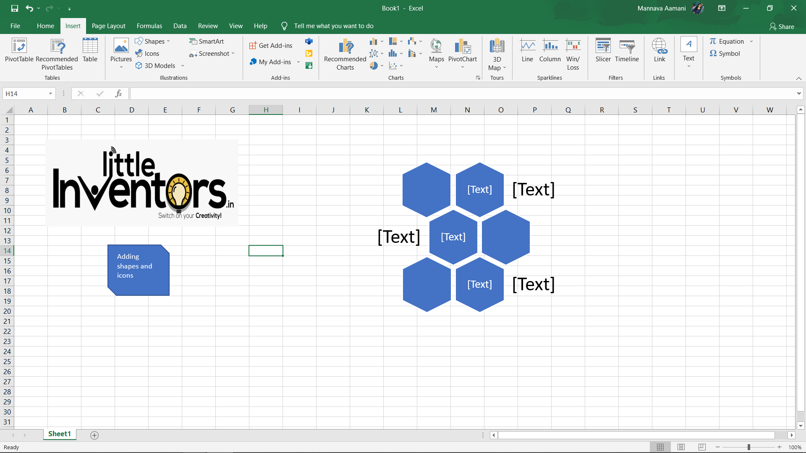

Inserting image and shapes

Slide 6
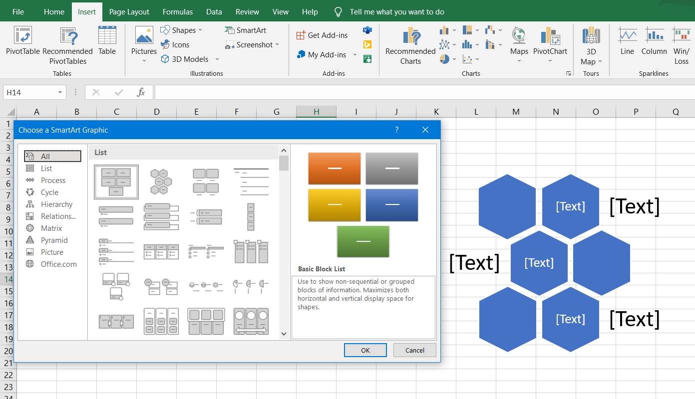
Adding smartart

Slide 7
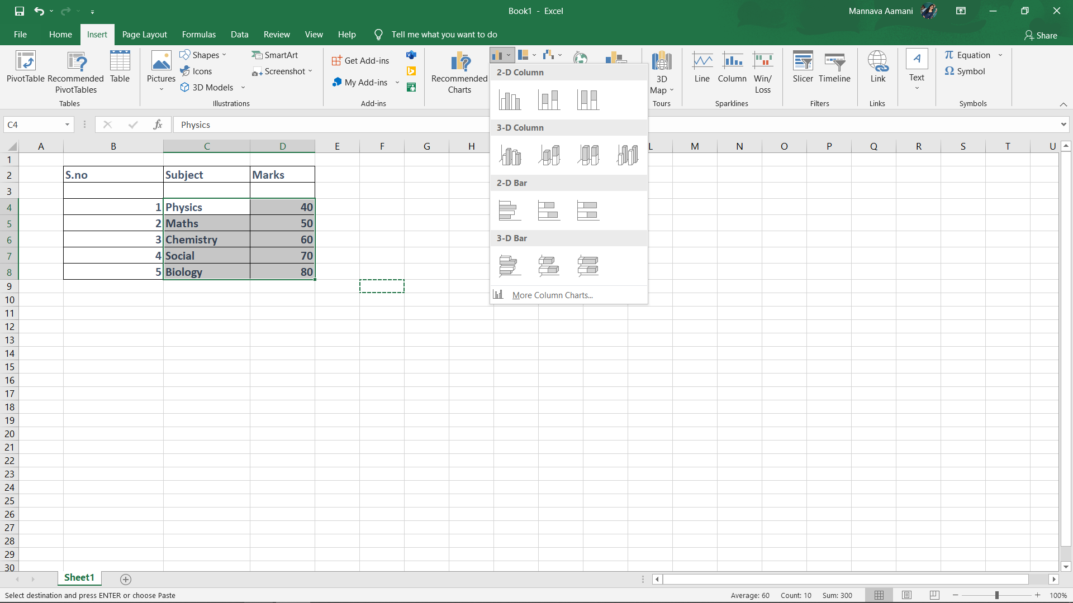
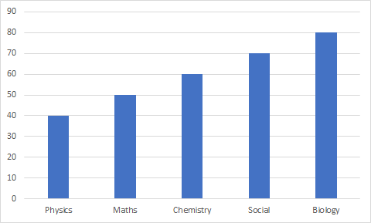
Add charts

Slide 8

Task
Open a new Excel sheet
Enter data in the cells(5 Names, 5 subjects with marks)
Draw different charts with that data
Save your project as “Charts”.

Slide 9
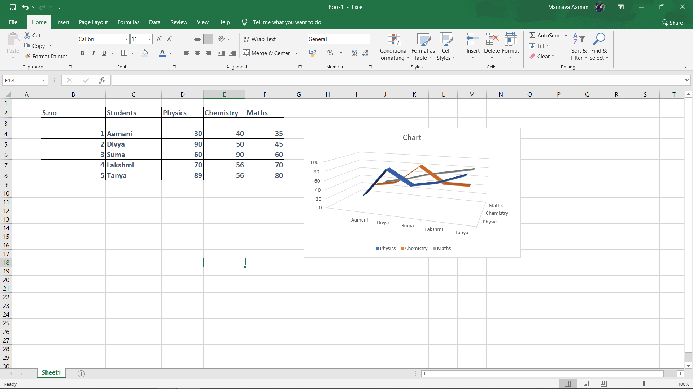
Solution

Slide 10

Homework
Open a new Excel sheet
Add a background image
Add a smartart and try adding different icons
Save your project as “Homework on images”.

Slide 11

ANY QUESTIONS ???

Slide 12



THANK YOU !
contact@littleinventors.in 0091-8368822963 www.littleinventors.in

